Slide 1
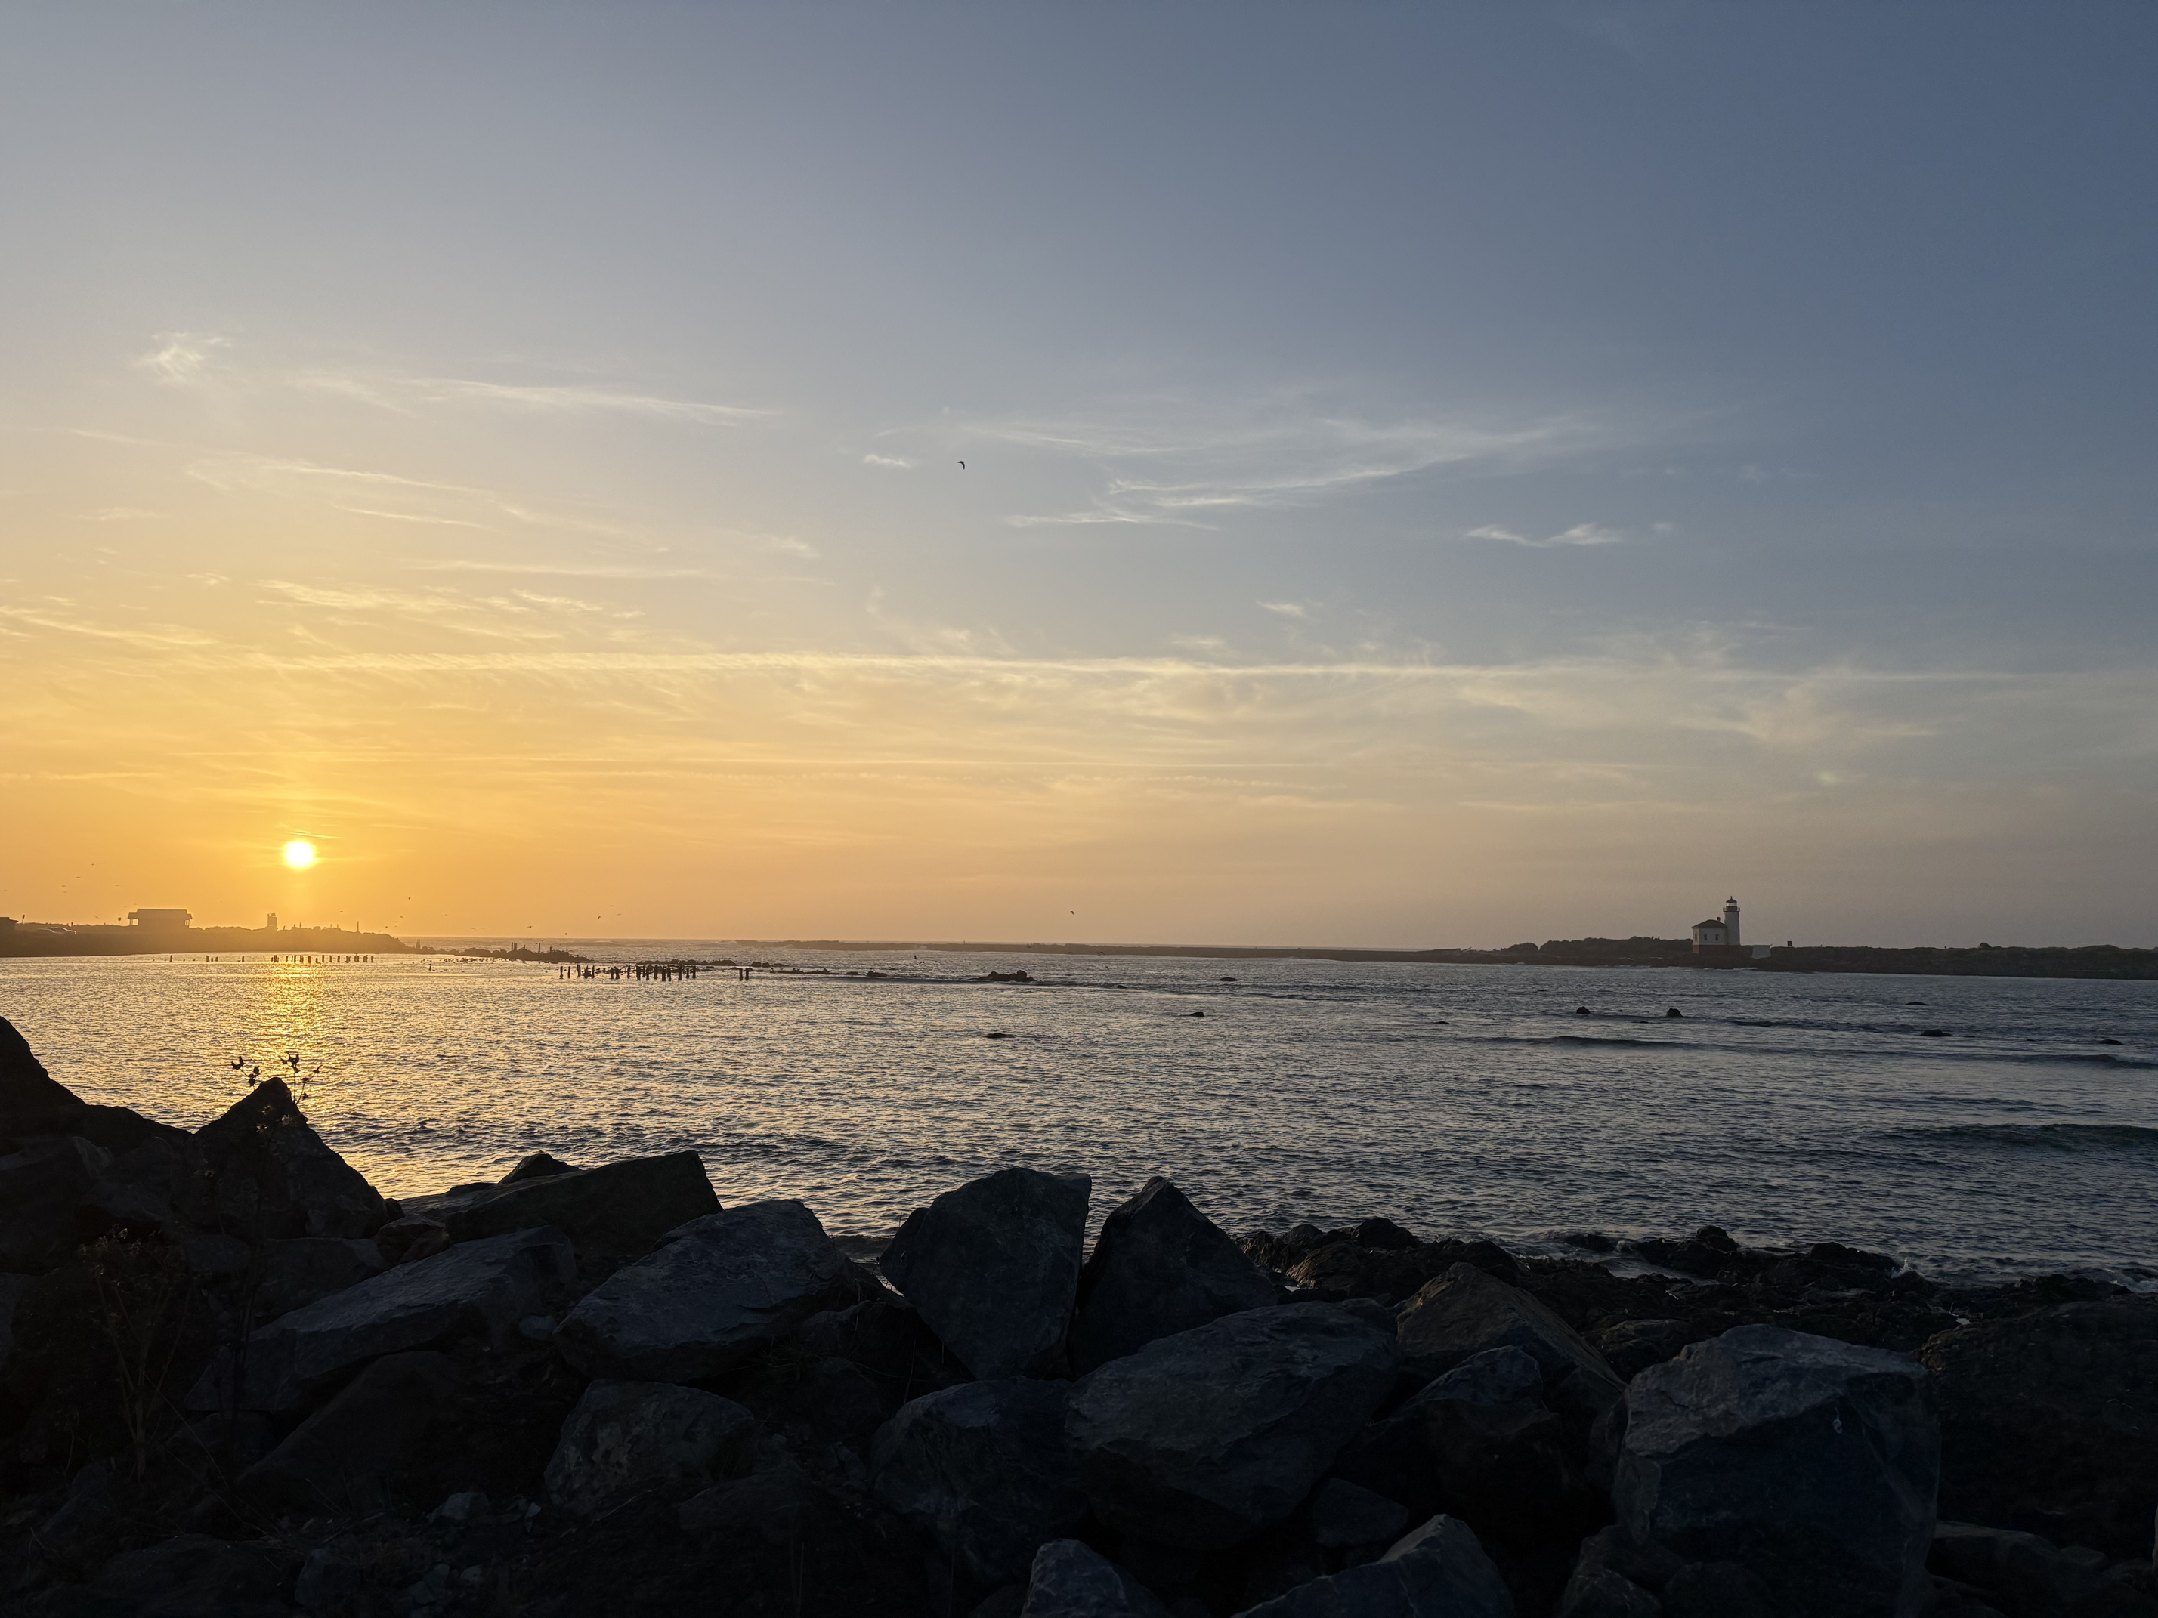
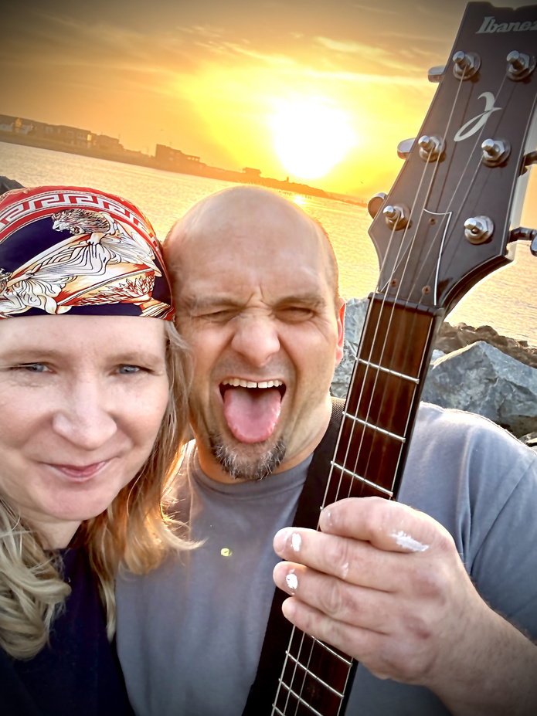
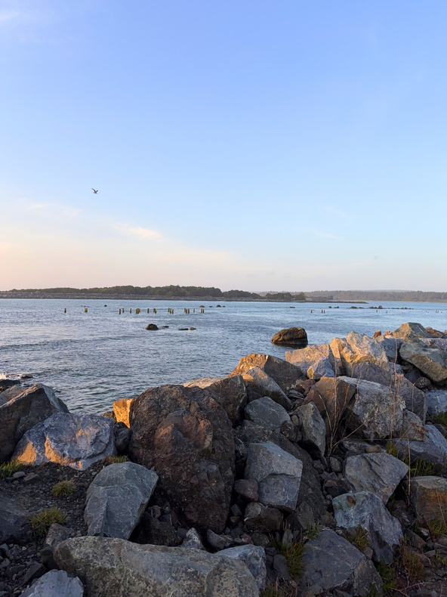
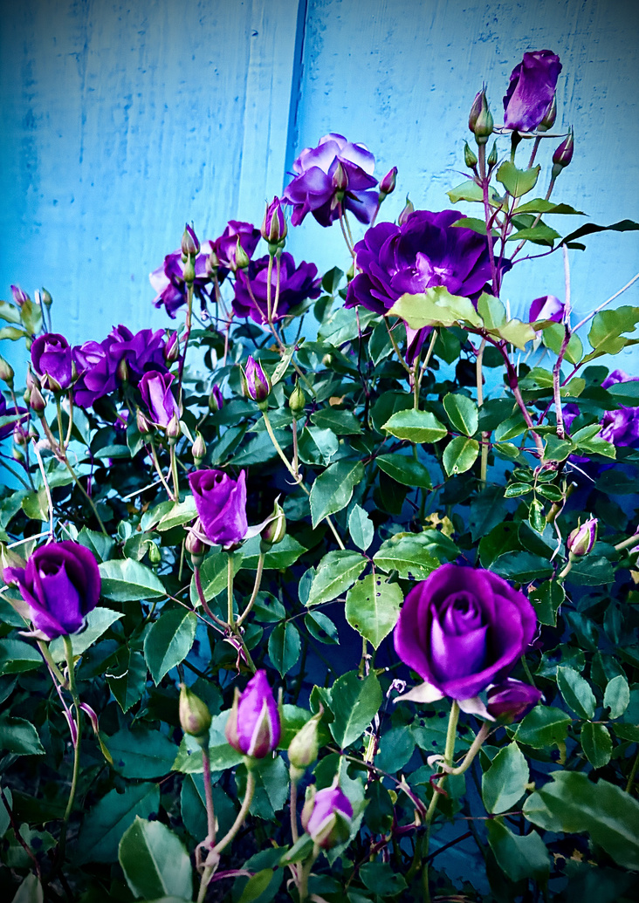
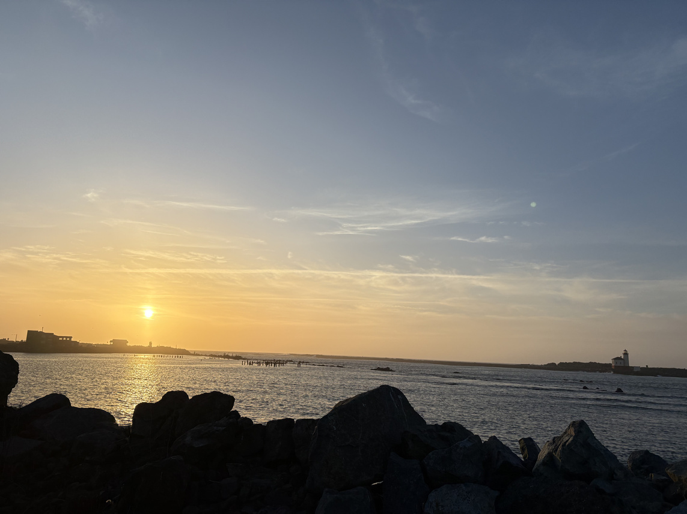
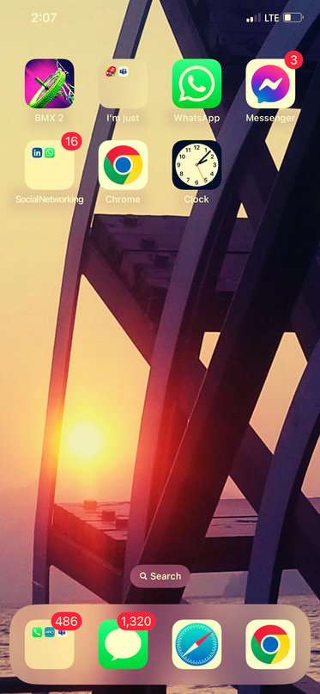

ANOTHER ONE DOWN
Turner Adventures
Chapter 26 Part 5
Feeling good feels great today! After no less than a full four-days spent sick in bed, we woke up this morning ready to make it a productive one. I spent most of my day between deep plague cleaning (iykyk) obsessing over our website’s details, and getting my office set up with a couple of new assistive devices. I’m pretty excited to start using a new screen reader and an app that casts my calendar and reminders to a big screen. Meanwhile, the boswain assigned tasks that I hadn’t thought of…yet. In the end, my deckhand skills were commended and he even picked up my favorite snacks; all because I made a point to reply with either, “heard’” or “yes sir, Mr Boswain.” What started out silly has become absurd. I honestly can’t think of a better way to walk the earth than with him nearby to navigate. Loudly, exuberantly, and with full-bodied gestures.
A RANDOM ADVENTURE THAT WE ALMOST MISSED - TURNED INTO ONE OF THE BEST!
His day was spent finishing up a painting job and then helping me with projects, so I know it was a tough shake-back day - so much more than mine. We needed to run a couple of errands and it was such a beautiful evening we knew we had to stop for a few to appreciate it.
I’m so glad we didn’t miss out on that random 20 minute side-track! It was a much-needed reset, and we even stopped to smell our own roses when we got home. Later, I saw the pictures and so many sweet memories came flooding back. Now I’ll need to write the prequel series.
CAUGHT THE SUNSET AND THE SINGING PAINTER IN THE WILD TONIGHT -5/23/26
As for Mr. Turner’s objection on photo choices…
I know you didn’t want me to add this photo of us looking a mess, but here’s why I love it. Almost every day you do and say special little things for me, and almost every day I’m still surprised by the peace we keep. Somehow we find the joy in every day - even on the really rough ones. Tonight, I’m surprised at how fortunate I am - I actually get to live and hang out with my best friend every day!
I know the picture isn’t your favorite, but it reminds me of when we first met. Literally, I was standing and you were there (and wouldn’t accept my mutism). I still can’t believe we got to spend evenings on a luxury riverboat, watching the sun set somewhere on the MS River…who would have thought we’d end up right here, living and working on another adventure?
Lisa Marie
www.TurnerAdVentures.com

